Slide 1
Micro-Credit Defaulter
Submited By:
Sayan Kumar Bhunia

Slide 2

OUTLINE
Introduction
Problem Statement
Project Specification
Dataset
Pipeline
Data Cleaning
Feature Engineering
Outlier Detection
Outlier Removal
One Hot Encoding
Feature scaling
Model Creation
cross validation
GridSearch cross validation
Key metrics
Conclusion

Slide 3

INTRODUCTION
For this project, I have to predict in terms of a probability for each loan transaction, whether the customer will be paying back the loan amount within 5 days of insurance of loan. In this case, Label ‘1’ indicates that the loan has been payed i.e. Non- defaulter, while, Label ‘0’ indicates that the loan has not been payed i.e. defaulter.
This project will very helpful for the financialmarket.
Classification algorithm is used to create a model with a great accuracy score.

Slide 4

PROBLEM STATEMENT
A Microfinance Institution (MFI) is an organization that offers financial services to low income populations. MFS becomes very useful when targeting especially the unbanked poor families living in remote areas with not much sources of income. The Microfinance services (MFS) provided by MFI are Group Loans, Agricultural Loans, Individual Business Loans and so on.
Many microfinance institutions (MFI), experts and donors are supporting the idea of using mobile financial services (MFS) which they feel are more convenient and efficient, and cost saving, than the traditional high-touch model used since long for the purpose of delivering microfinance services. Though, the MFI industry is primarily focusing on low income families and are very useful in such areas, the implementation of MFS has been uneven with both significant challenges and successes.
Today, microfinance is widely accepted as a poverty-reduction tool, representing $70 billion in outstanding loans and a global outreach of 200 million clients.
A client from Telecom industry collaborating with an MFI to provide micro-credit on mobile balances to be paid back in 5 days. The Consumer is believed to be defaulter if he deviates from the path of paying back the loaned amount within the time duration of 5 days. For the loan amount of 5 (in Indonesian Rupiah), payback amount should be 6 (in Indonesian Rupiah), while, for the loan amount of 10 (in Indonesian Rupiah), the payback amount should be 12 (in Indonesian Rupiah).

Slide 5

PROJECT SPECIFICATION
The goal of this project is to predict whether the customer will be paying back the loaned amount within 5 days of insurance of loan. In this case, Label ‘1’ indicates that the loan has been payed i.e. Non- defaulter, while, Label ‘0’ indicates that the loan has not been payed i.e. defaulter.
We are using Machine Learning Algorithm to create a predictive model.
Classification algorithm is used to train and test the model in our project.

Slide 6

DATASET
Link of the dataset-
C:\Users\sayan\OneDrive\Desktop\Data file.csv”
I am using CSV (comma-separated values) format file which is having 209593 rows × 37 columns.
We have used a total of 36 input variable and 1 output/target v ariable to train our machine learning model.

Slide 7
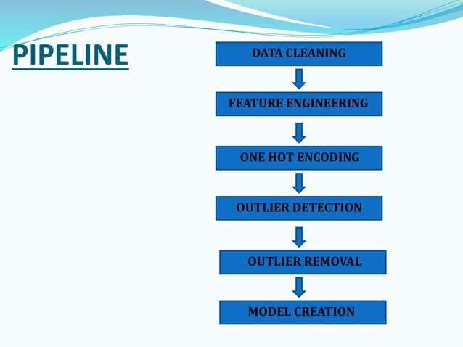

Slide 8

DATA CLEANING
The main aim of Data Cleaning is to identify and remove errors &
duplicate data, in order to create a reliable dataset.
The process of data cleaning is done by usinga very famous library pandas.
Initially, those columns/features are dropped from dataset which are not important for prediction..
The rows having a null value in any colurnns are dropped from dataset.
The columns having characters as well as integer values are converted into integer values only.
Many more data cleaning techniques are used to improve the quality of dataset.

Slide 9

FEATURE ENGINEERING
Feature engineering is the process of using domain knowledge to extract features from raw data via data mining techniques. These features can be used to improve the performance of machine learning algorithms. Feature engineering can be considered as applied machine learning itself.
Dimensionality reduction techniques are used in dataset to reduce those rows which are not very much important for predicting target value.

Slide 10

OUTLIER DETECTION
In simple words, an outlier is an observation that diverges from an overall pattern on a sample.
There are many types of outlier detection techniques such as Z-Score or Extreme Value Analysis, Probabilistic and Statistical Modeling, Information Theory Models, Standard Deviation etc
In the following case box plot is used to detect outliers.

Slide 11

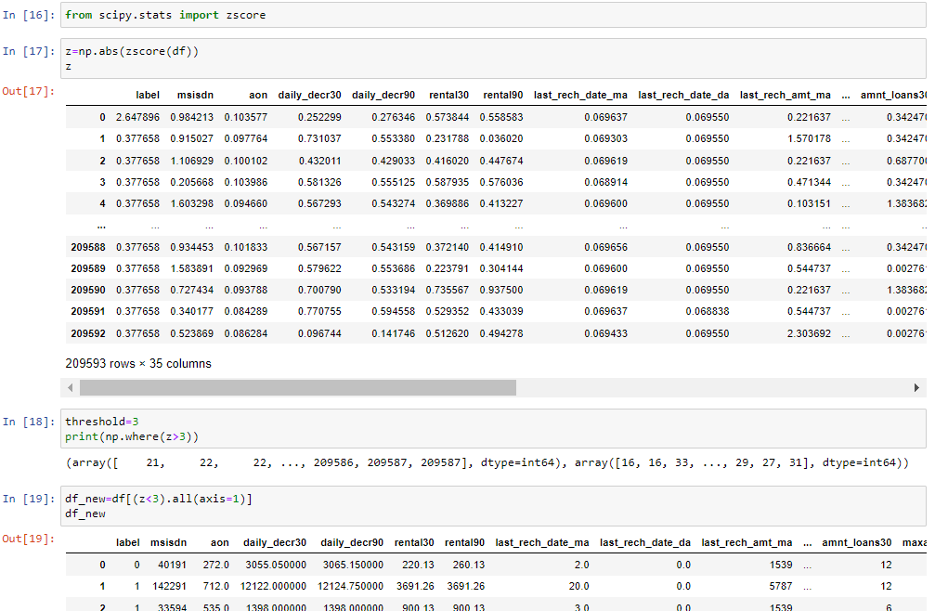
OUTLIER REMOVAL
After detecting the outlier, correct that errors if possible and if you can not fix it, then remove that observation.
In our dataset, we observed variations in the relation between values of some attributes.
So that these type of rows are dropped from the dataset.

Slide 12

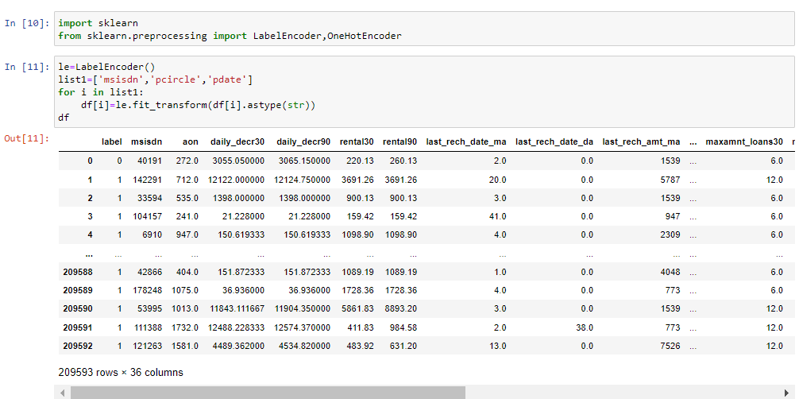
ONE HOT ENCODING
This technique is used to convert the categorical variables into numeric values.
As we can see there are 3 object in this dataset object type columns present so we will encode it into (int) format.
Apply Label Encoding, if number of categories in a categorical variable is equal to 2.
Apply One-Hot Encoding, if number of categories in a categorical variable is greater than 2.

Slide 13
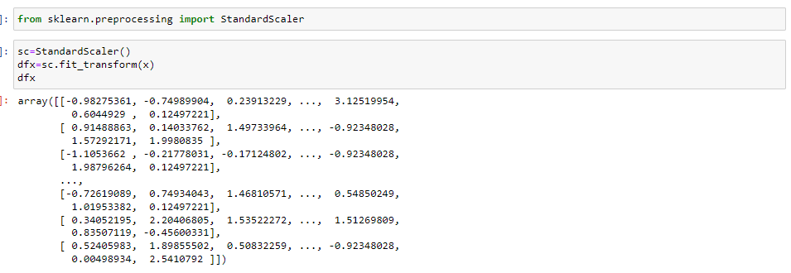
Feature scaling
Feature Scaling ensures that all features will get equal importance in supervised classifier models. Standard scaler was used to scale all features in the data.

Slide 14

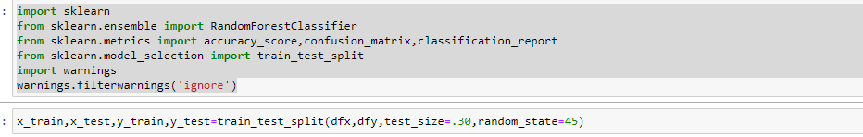
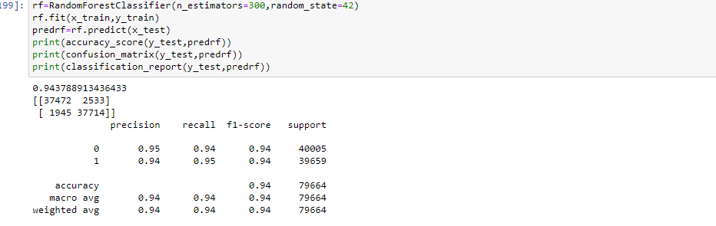
MODEL CREATION
The process of modeling means training a machine learning algorithm to predict the labels from the features.
We have used Random Forest Classifier algorithm for trainig and testing of the model.
The accuracy rate of our model is 94% which is pretty good.

Slide 15

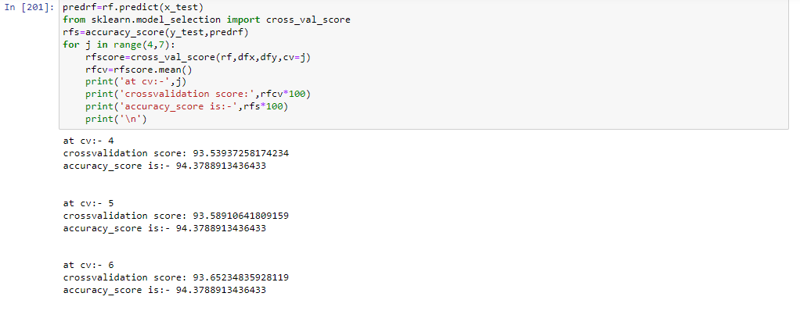
CROSS VALIDATION
Cross-validation is a statistical method used to esti1nate the skill of machine learning models.
It is commonly used in applied machine learning to compare and select a model for a given predictive modeling problem because it is easy to understand, easy to implement, and results in skill estin1ates that generally have a lower bias than other methods.
After applying k-fold cross validation method into our final dataset, we find our accuracy rate is more than 94% all the time.

Slide 16

GRIDSEARCH CROSS VALIDATION
This is a technique which is used to find the best algorithm for modeling and give best parameters as well.
We applied grid search cross validation method on our dataset with Random Forest Classification.
We find the Random Forest Classification algorithm is giving the best accuracy score as more than 95%.

Slide 17
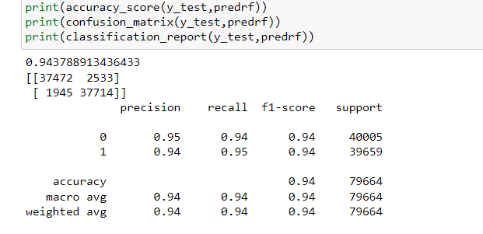
Key Metrics
Selection of a model requires evaluation and evaluation requires a good metric. This is indeed important. If we optimize a model based on incorrect metric, then, our model might not be suitable for the business goals.
We have a number of metrics, for example, accuracy, recall, precision, F1 score, area under receiver operating characteristic curve, to choose from.

Slide 18

conclusion
Key aspects of building successful classifier are:
Selecting correct data according to the purpose or problem statement.
Proper processing and understanding of the data
Selecting the model and optimizing the model.
In this project I have dealt with outliers and using z score I removed those outliers for better accuracy.
I have used label encoder for encoding object data type into int datatype as machine doesn’t understand object type data.
I have performed Smote operation as data was imbalanced.
I have used three classification model and found Random Forest Classifier to be the best fit. It is giving 94% accuracy.

Slide 19
THANK YOU

